Slide 1
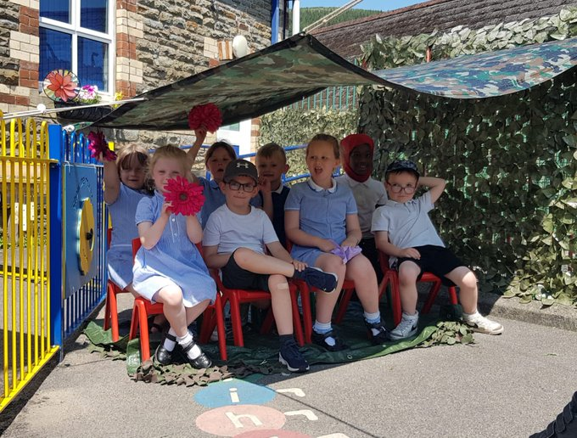

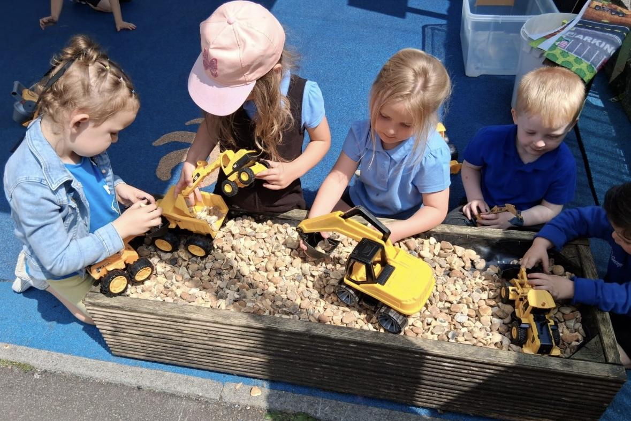
Croseo i Ysgol Penrhiwceibr
Positive, Polite and Safe

Slide 2
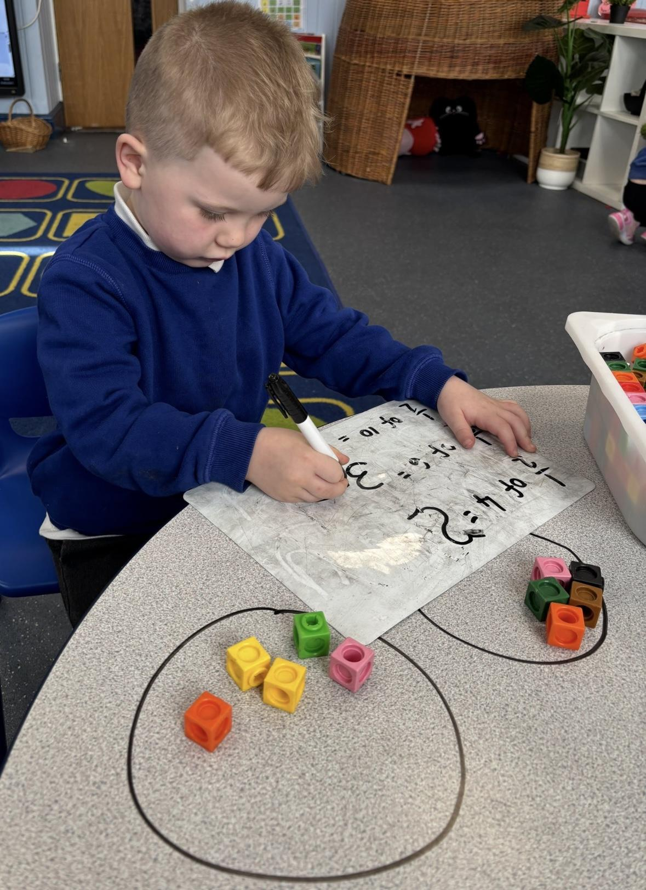
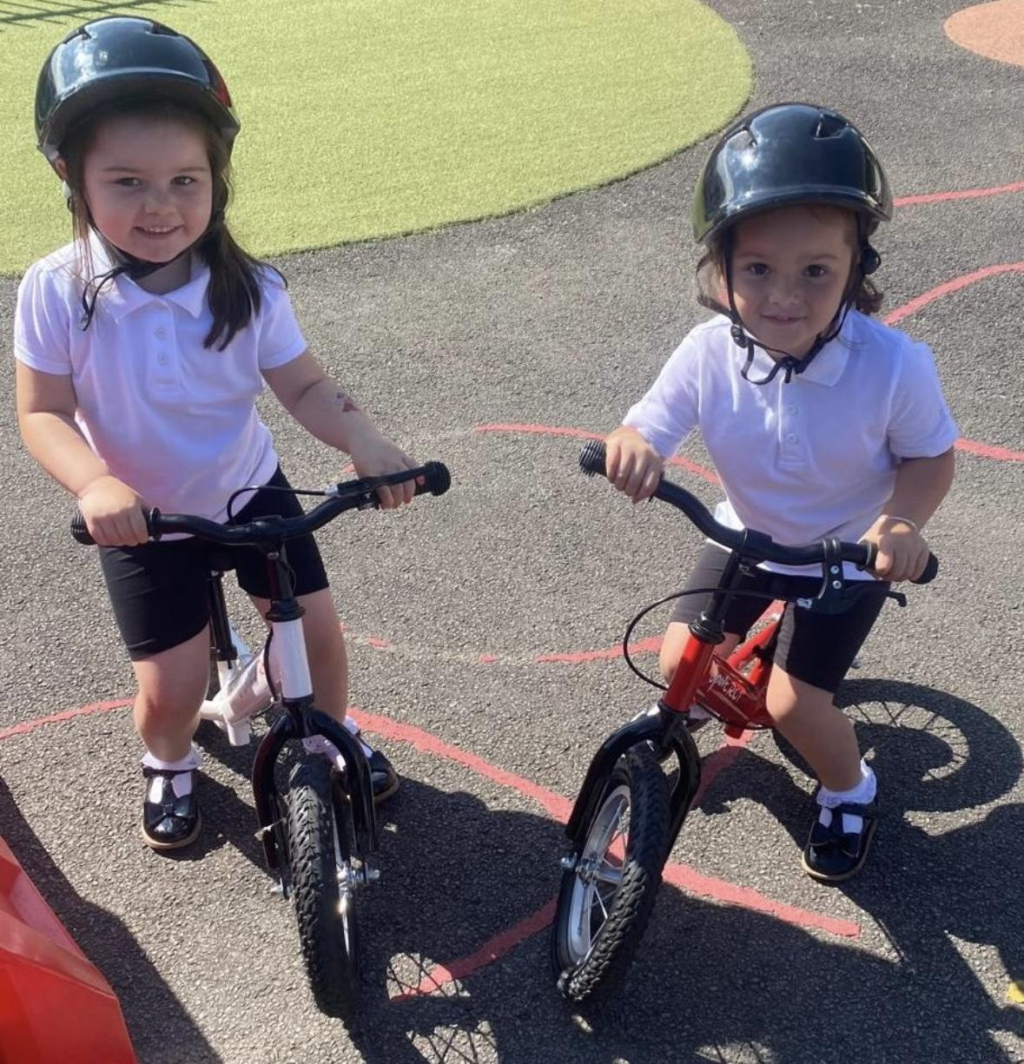
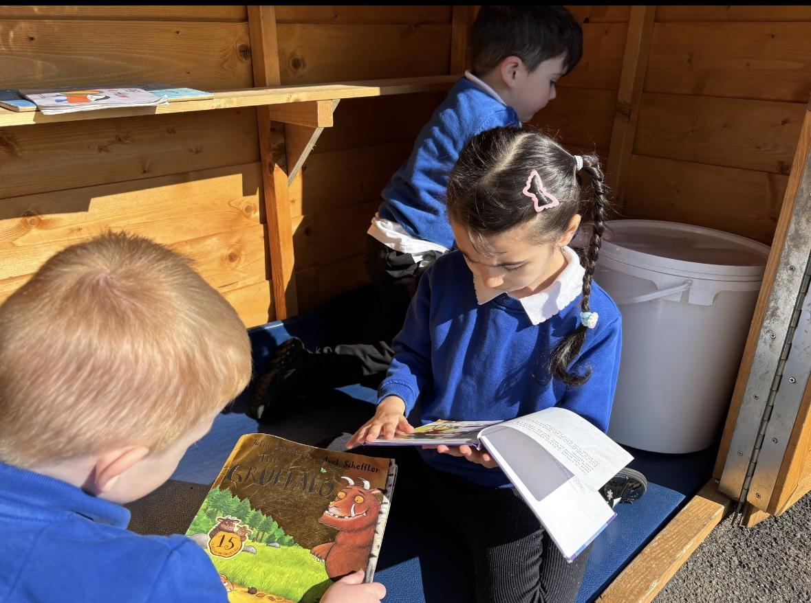
Welcome
Building relationships with your child and yourselves
Ensuring your child feels safe and secure
Ensuring your child is happy
Our door is always open
Positive home/school link

Slide 3
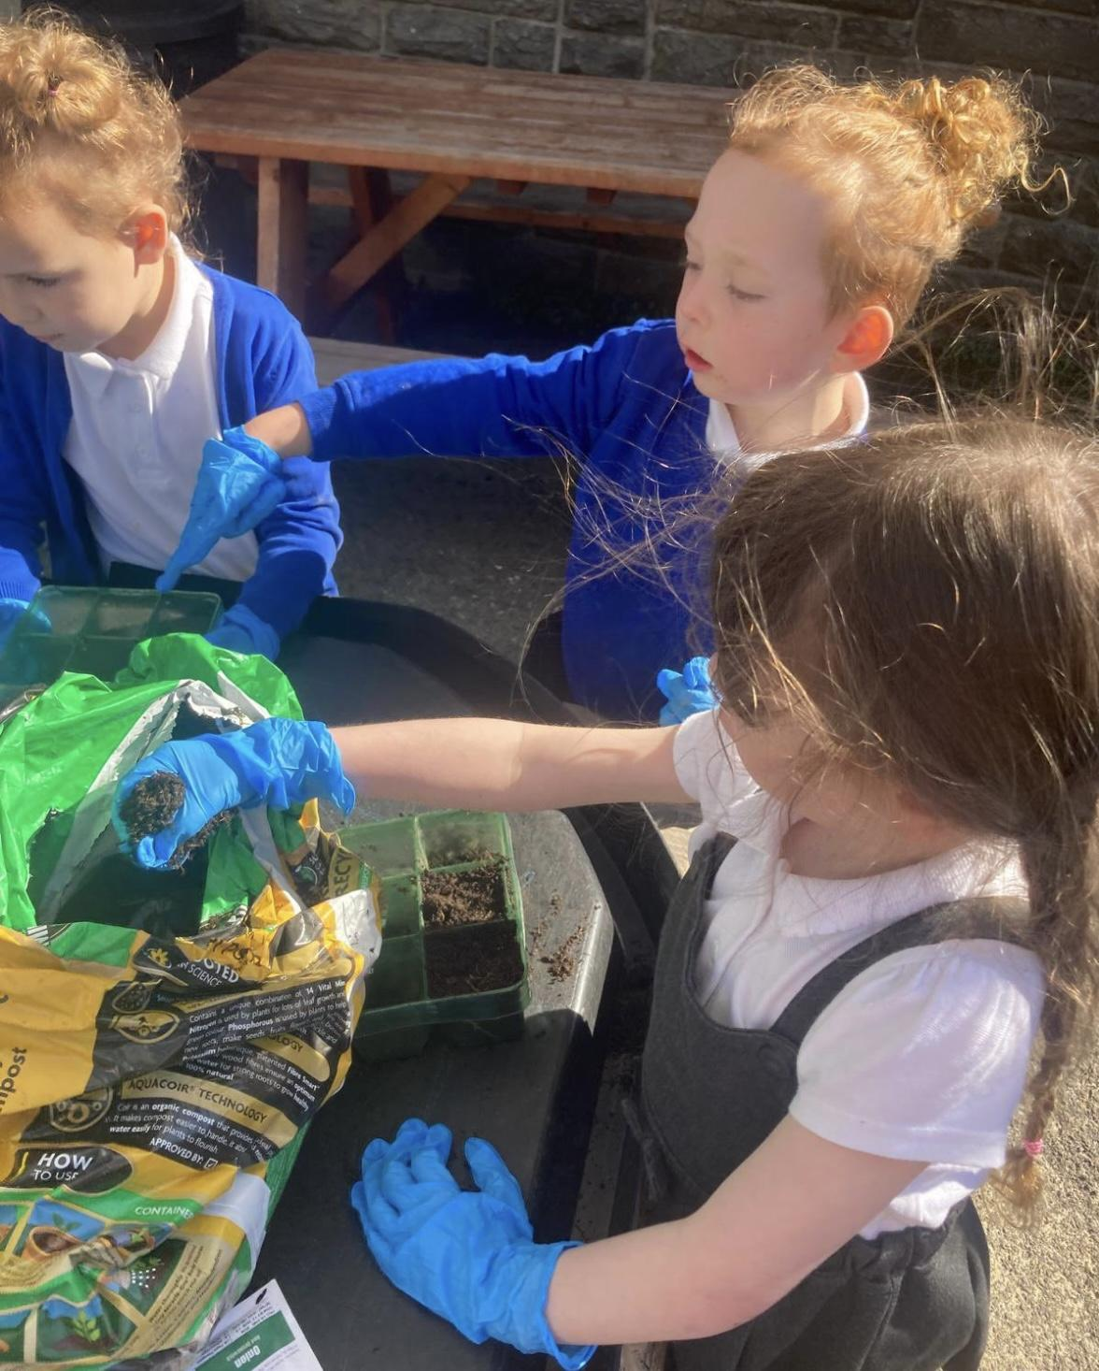
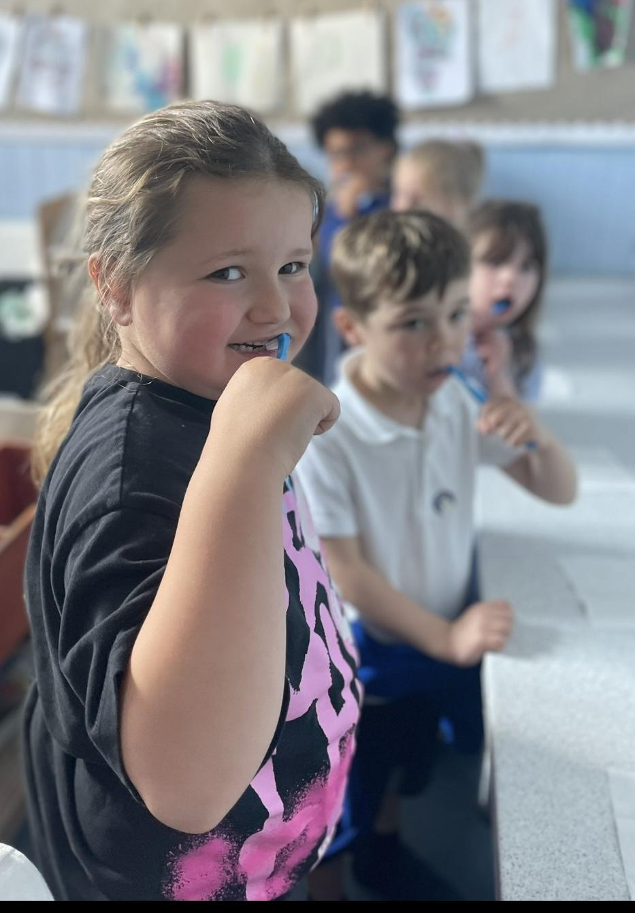
Coming to school
School starts at 8.50am and children to be collected at 12pm until we feel they are ready to stay for lunch. When we feel that your child is ready to stay for lunch they will be invited to stay until 12.40pm
Lunch times- Table manners, knives and forks.
Please ensure ALL uniform is labelled with your child's name.
Fruit and water- to be labelled.
Toilet trained.
Appropriate clothing- coats, hats, sun hats, wellies

Slide 4

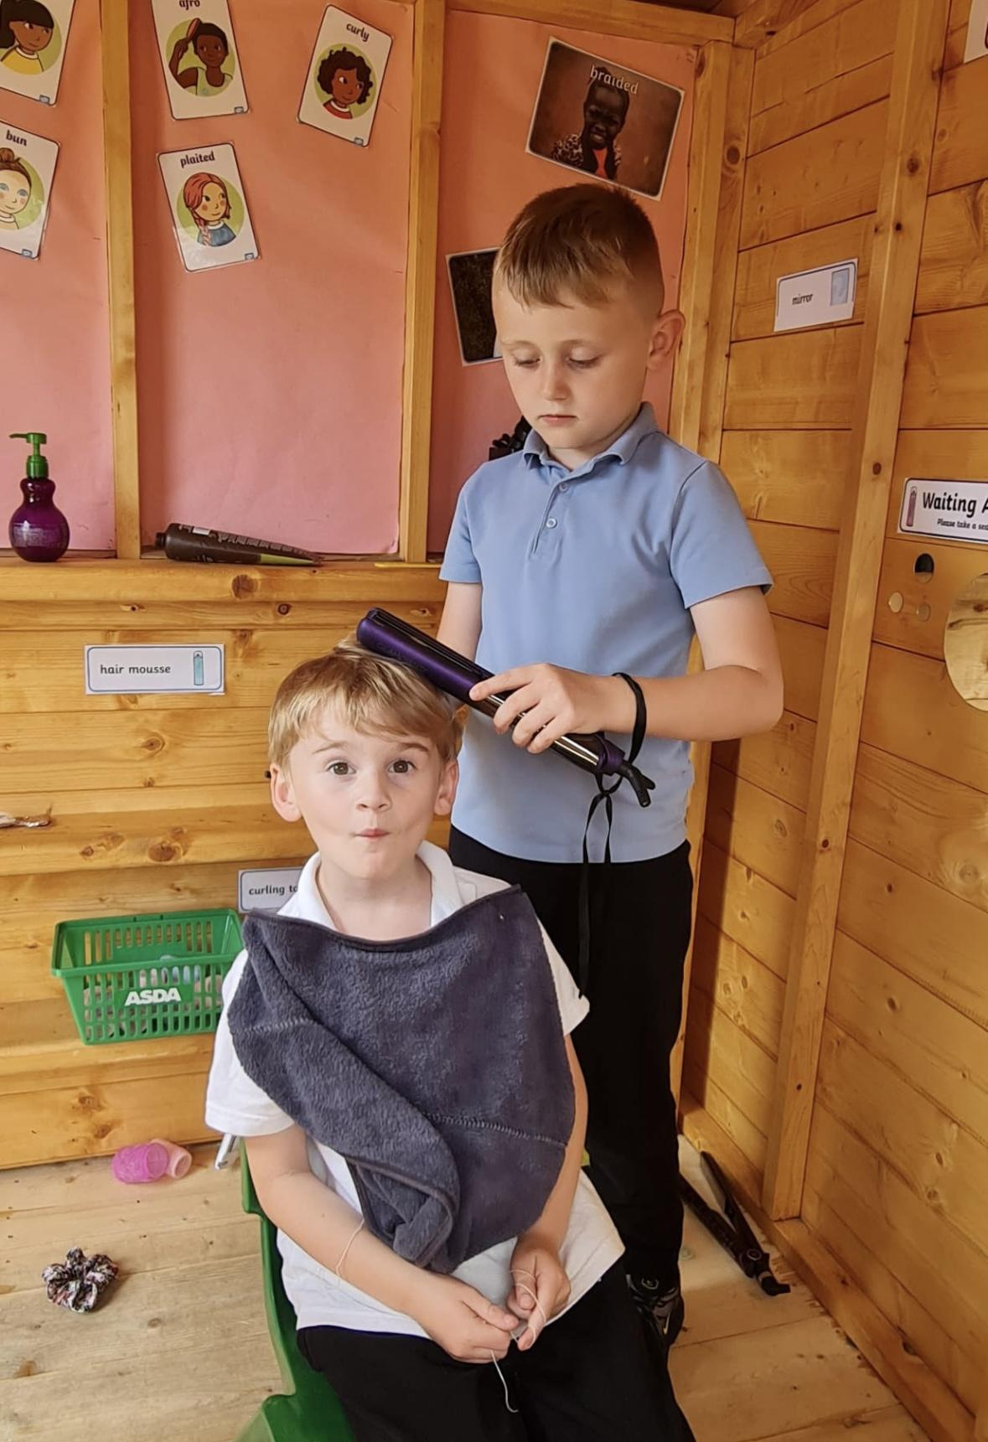
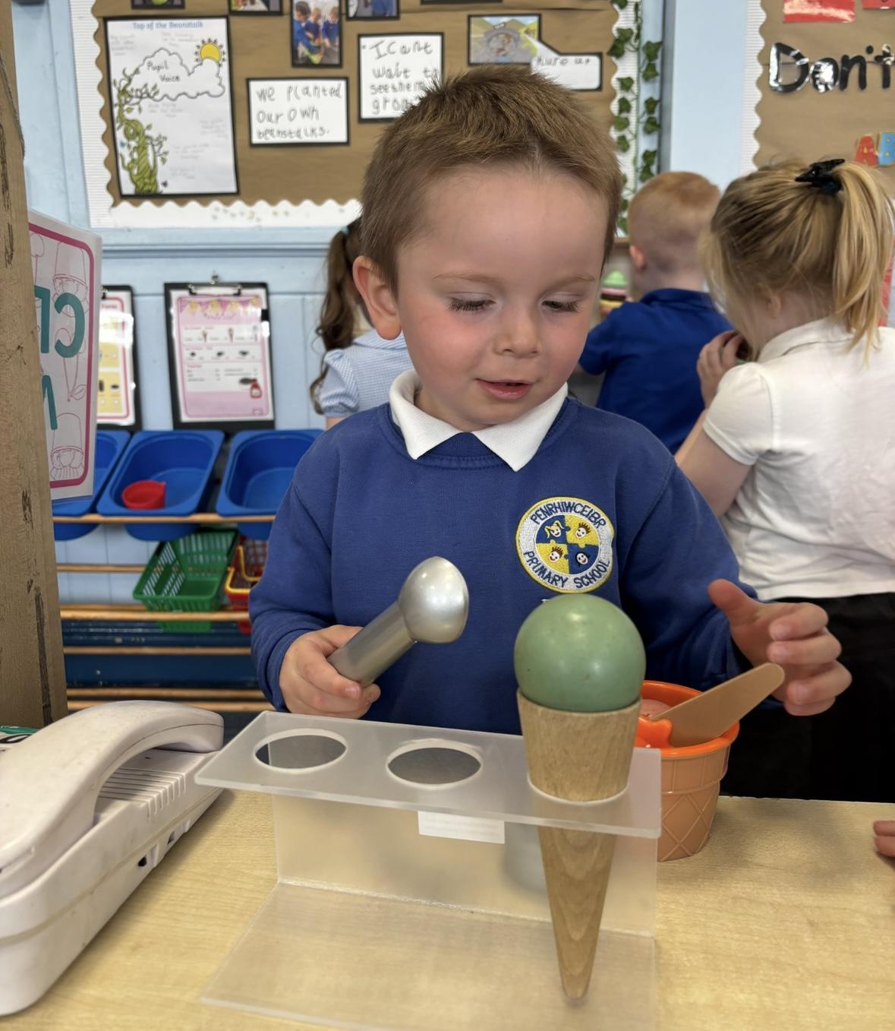
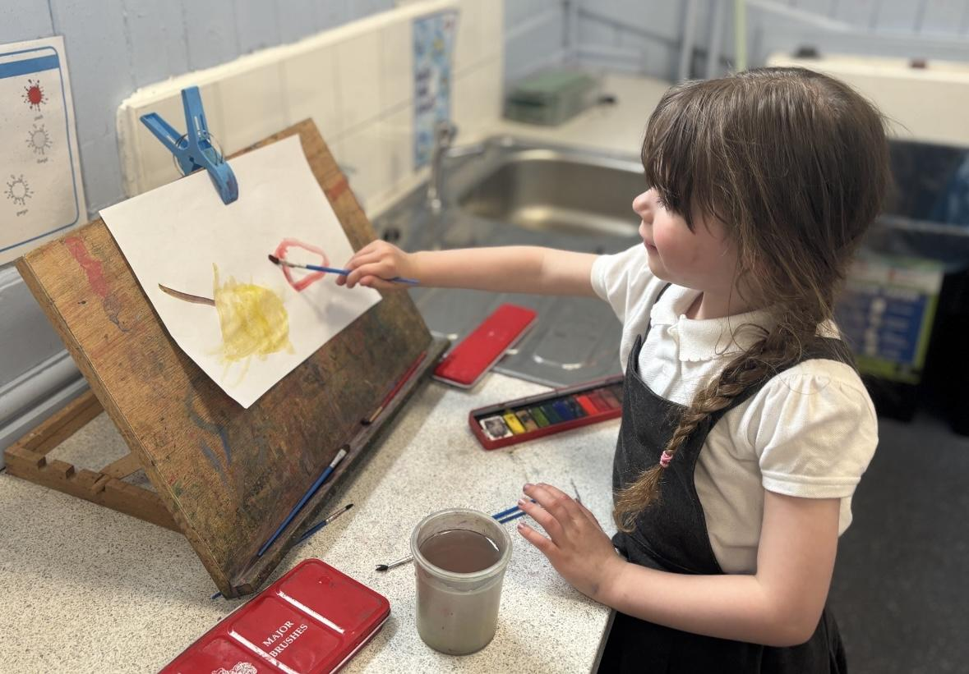
Learning
Play based learning environment - indoors/outdoors
Social & emotional - turn taking, managing emotions
Oracy - having conversations, eye contact, listening
Phonics- Read Write Inc.
Name recognition and writing.
Number recognition/ writing to 10.
Holding and using a scissors correctly.

Slide 5
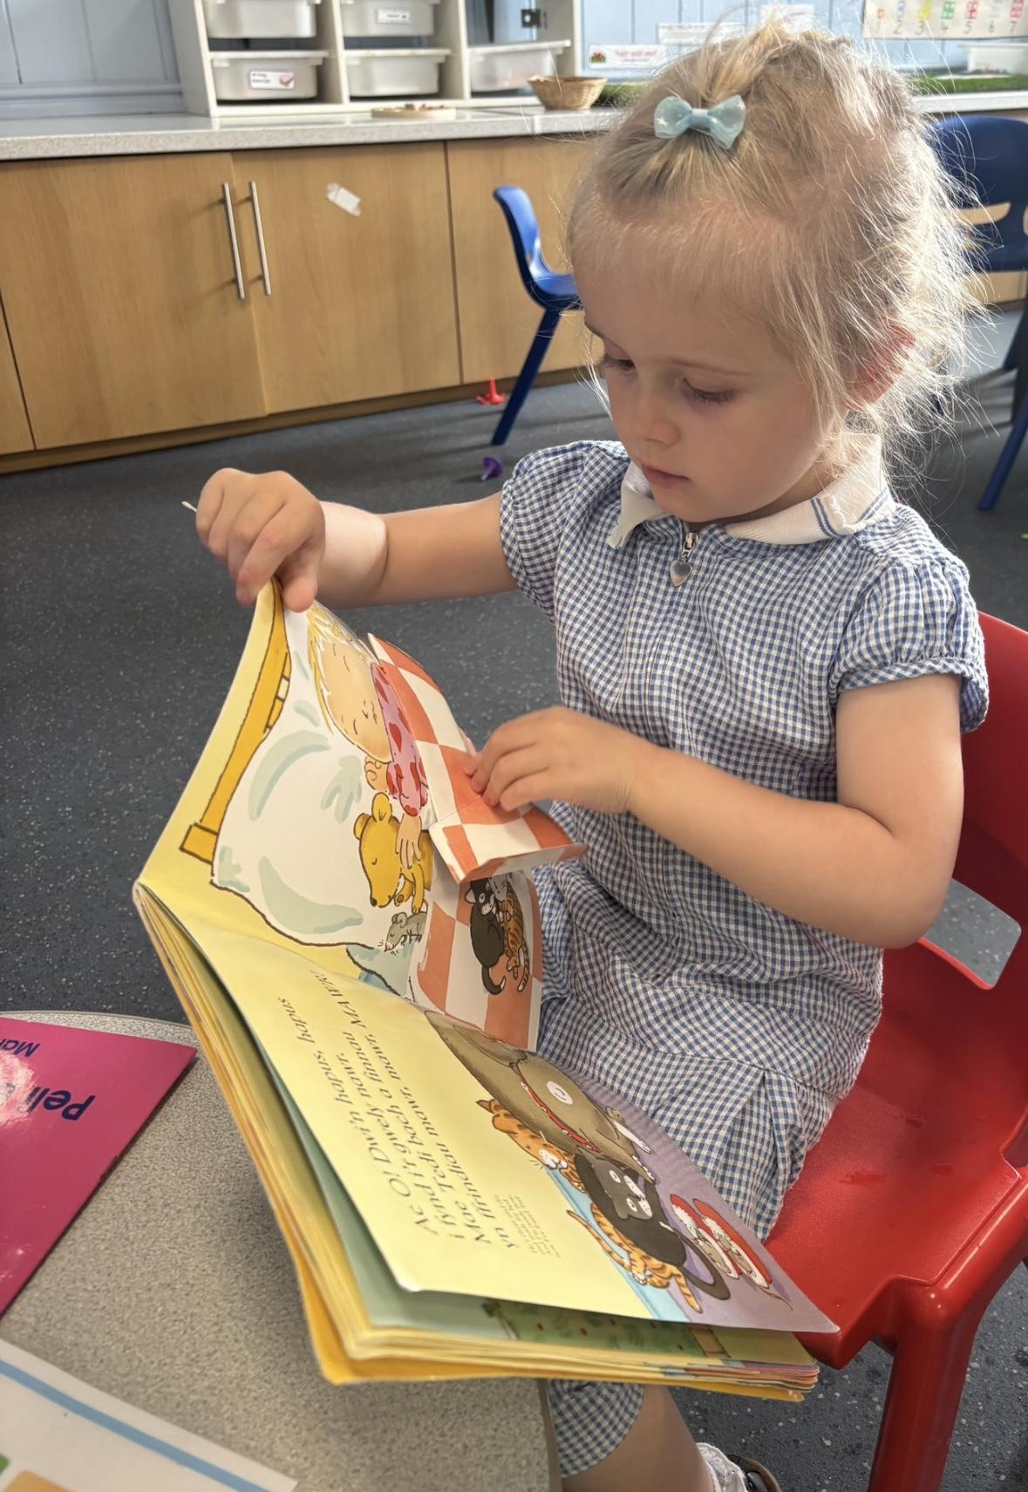
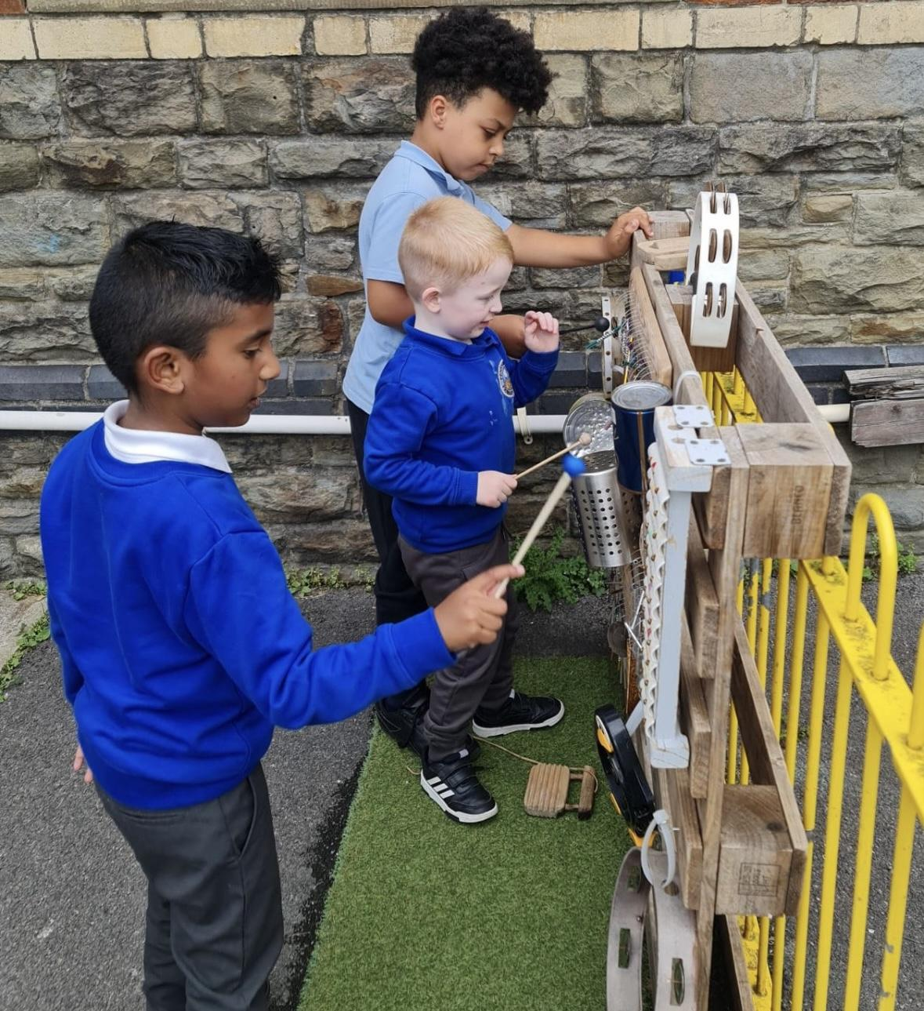
What can you do at home?
Having a good routine- brush your teeth, story and bed.
Reading stories at home.
Developing independence - coats, zips, shoes
Toilet training over the holidays.
Listening skills
Sitting at a table to eat- ensure readiness
to stay for lunch in school
Our doors are always open.

Slide 6
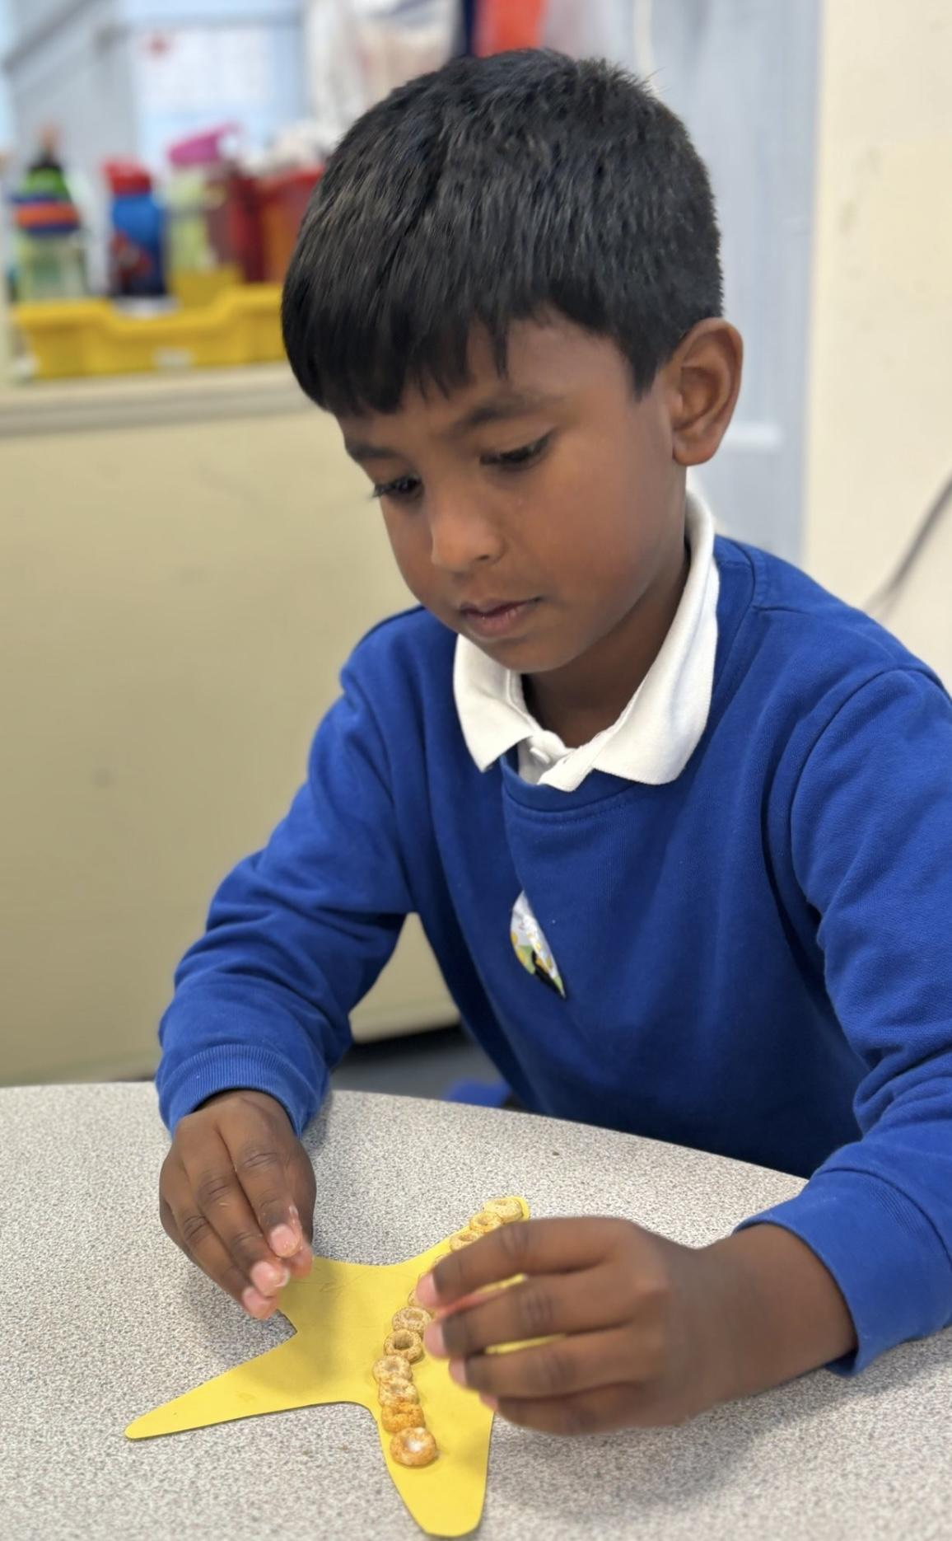
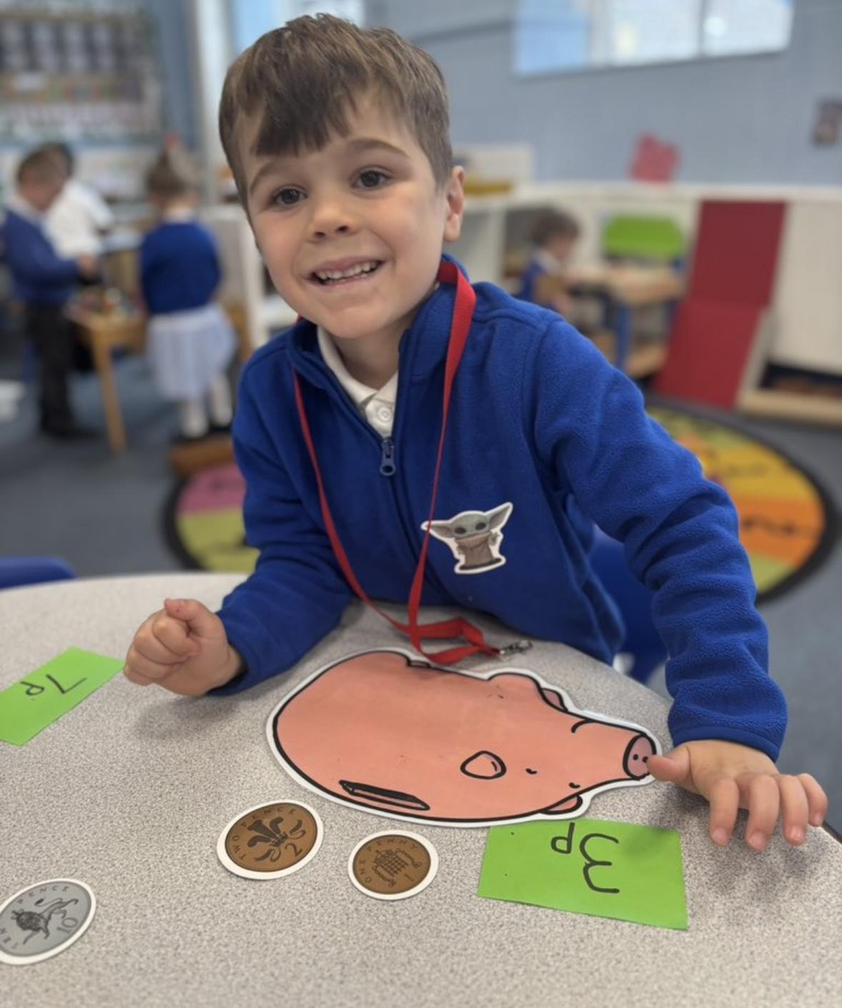
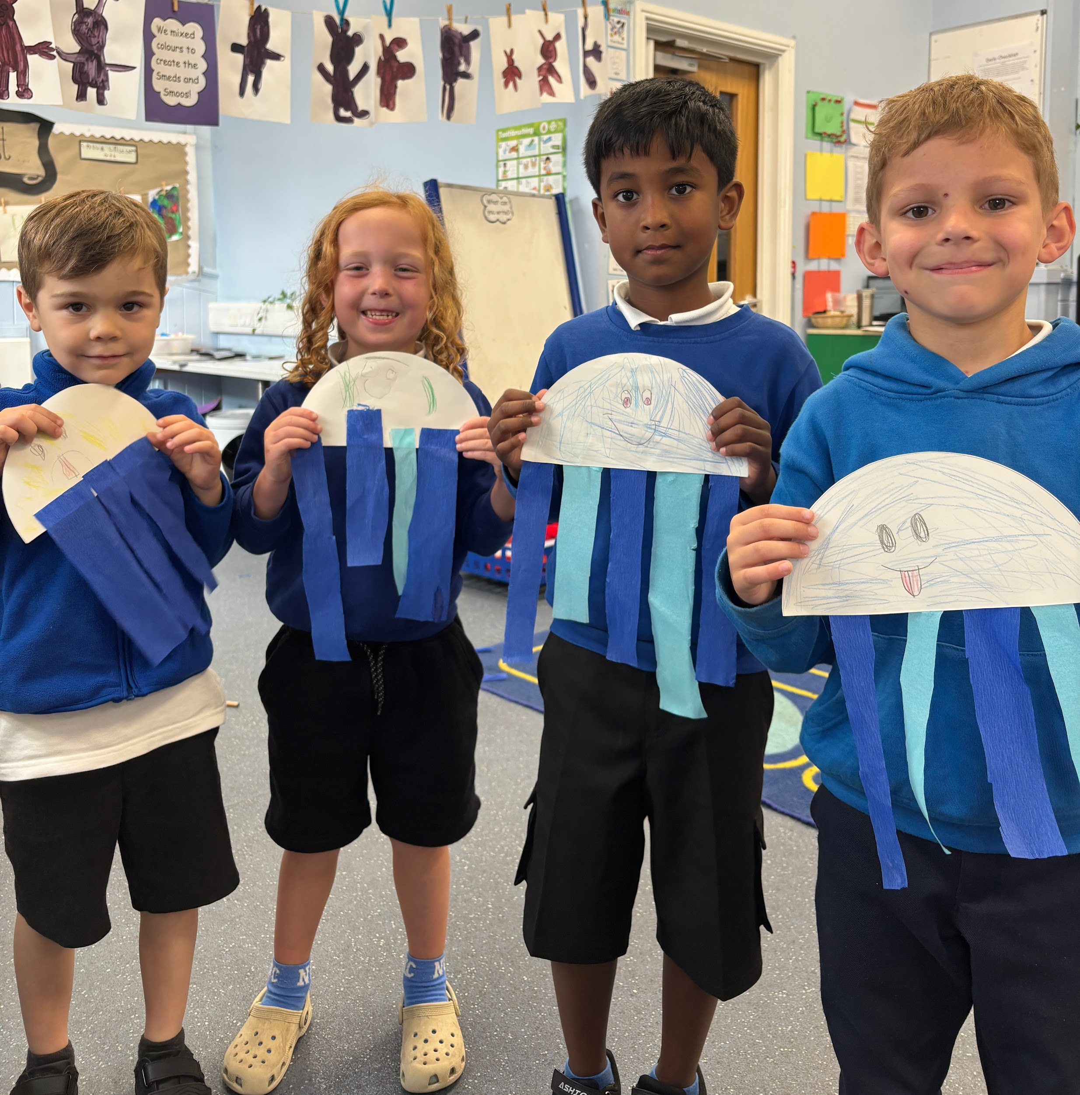
Support in school
Uniform available
Food store
Personal hygiene
Links with school nurse and other agencies

Slide 7
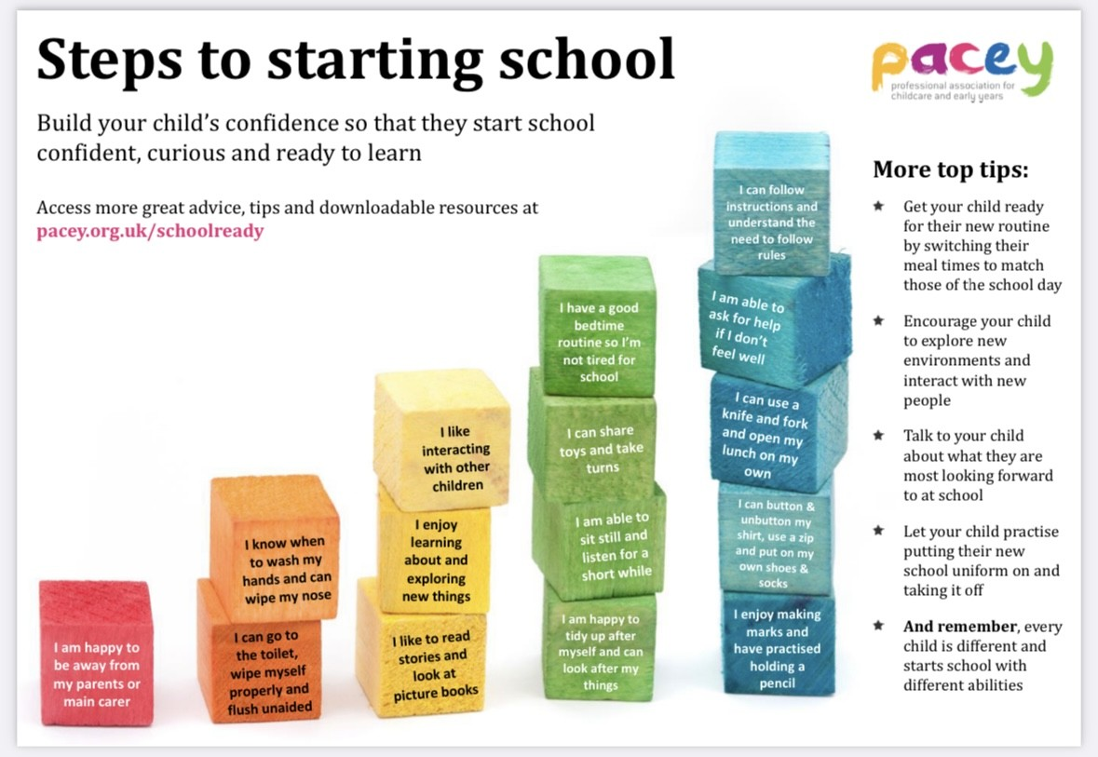

Slide 8
Diolch
Any questions?

